Slide 1
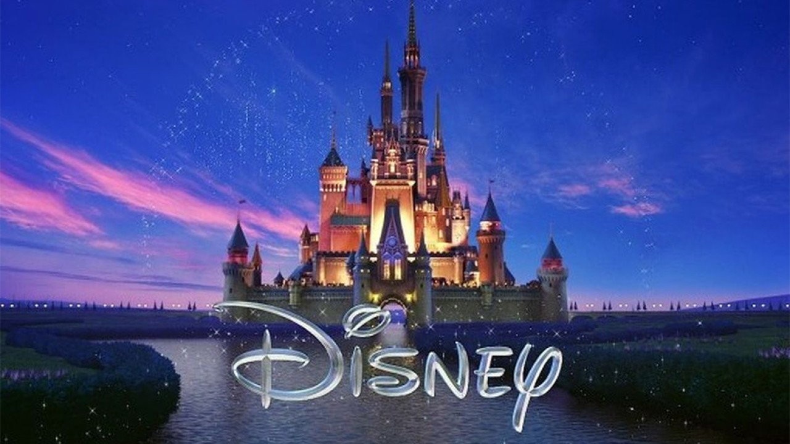
The Quiz

Slide 2
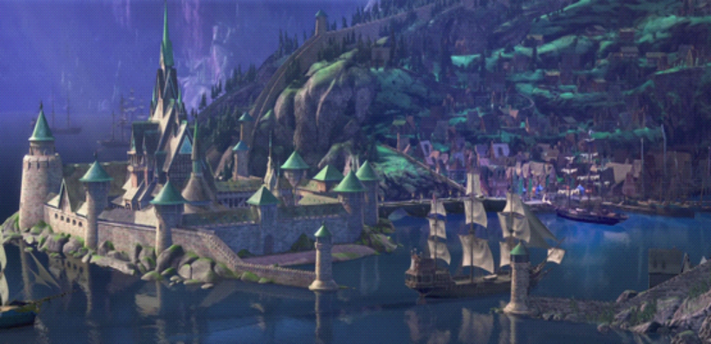
1. What is the name of Elsa and Anna's Kingdom in Frozen?

Slide 3
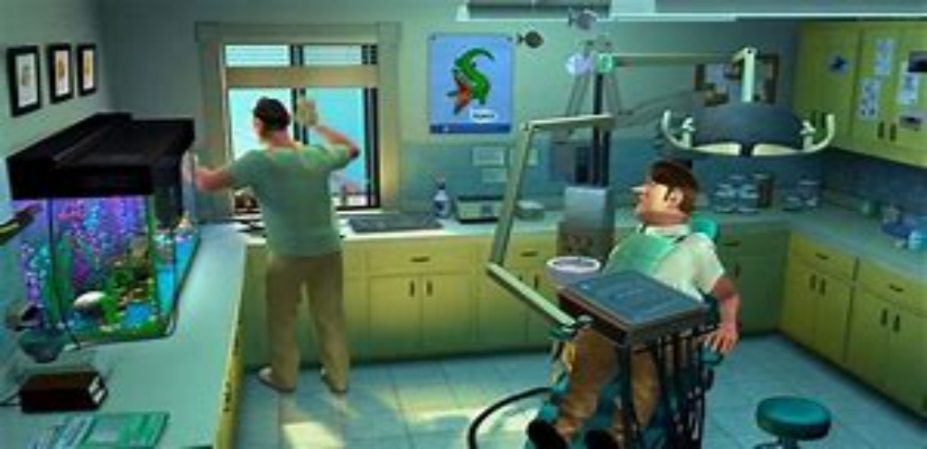
2. What is the address of the Dentist office in which Nemo is kept in Finding Nemo?

Slide 4
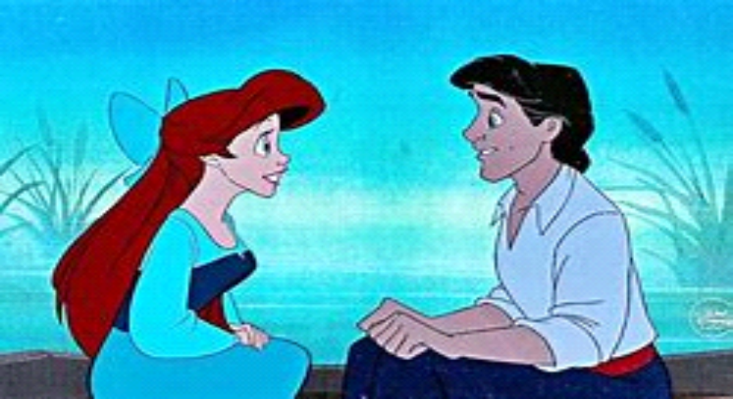
3. What is the name of the Prince that Ariel falls in love with in The Little Mermaid?

Slide 5
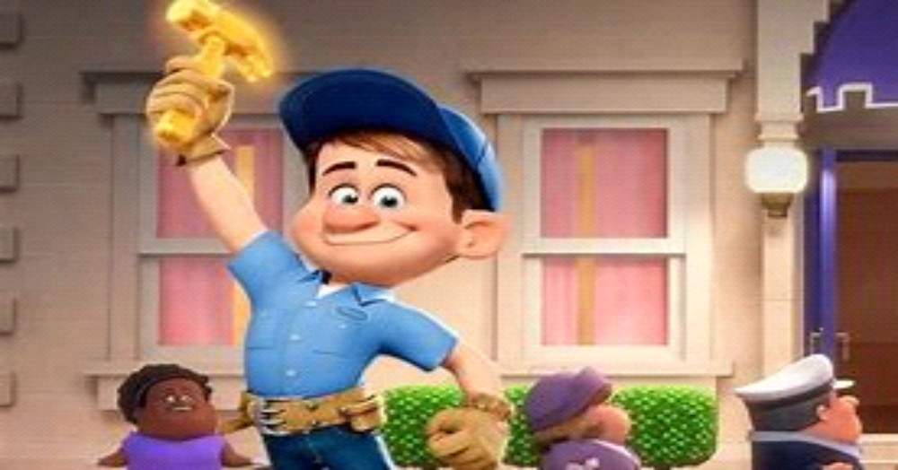
4. In Wreck It Ralph, what is the name of the 'good guy' in Ralph's game?

Slide 6
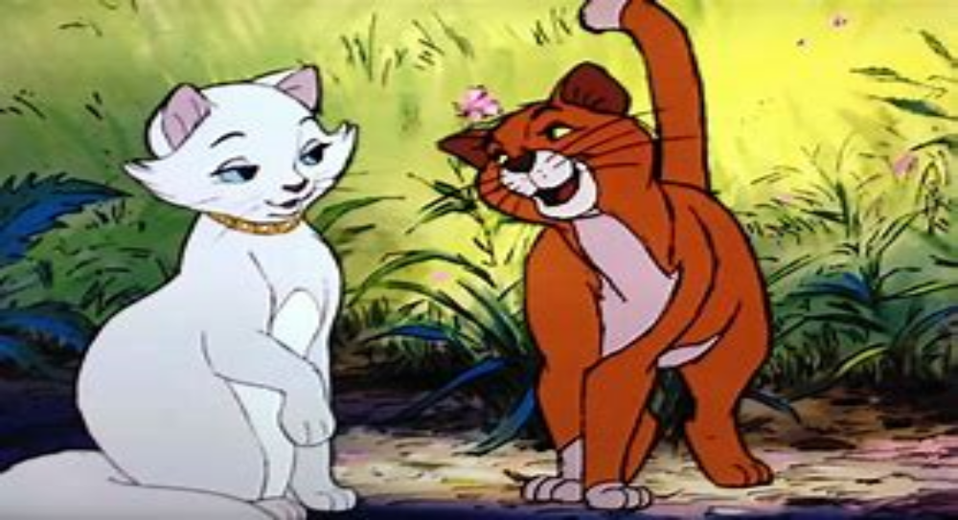
5. In The Aristocats what is the name of the streetcat who befriends Duchess and her kittens?

Slide 7
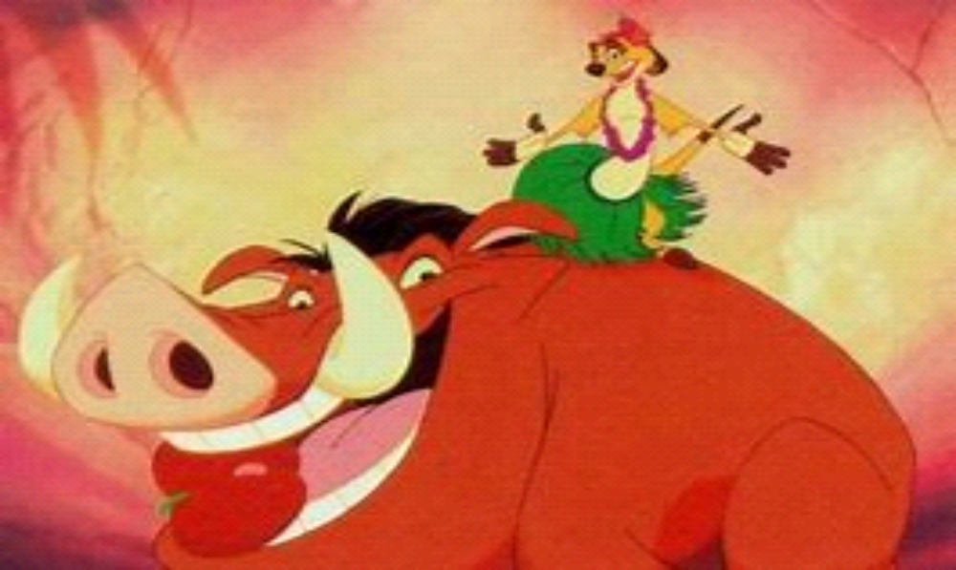
6. In the original 1994 version of The Lion King, which characters distract the hyenas with a Hawaiian luau?

Slide 8
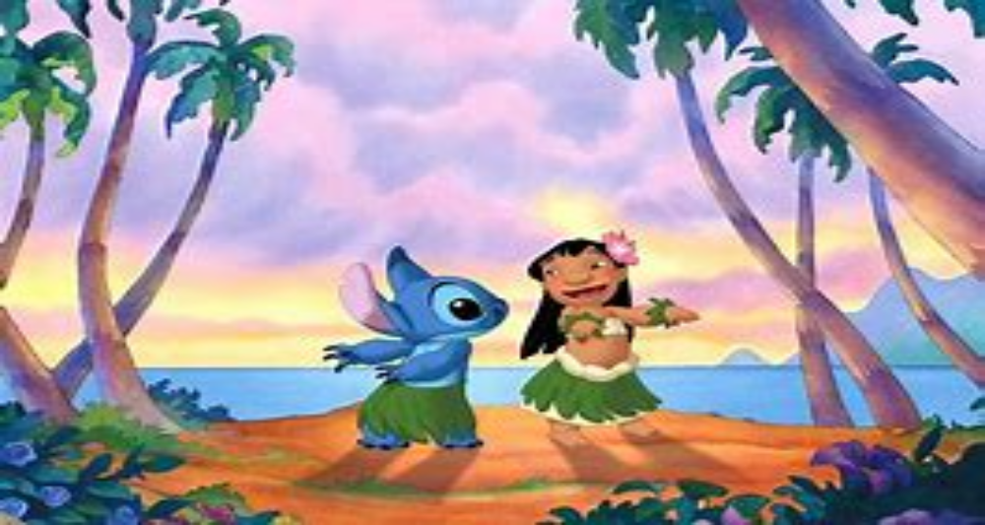
7. Where is Lilo & Stitch set?

Slide 9
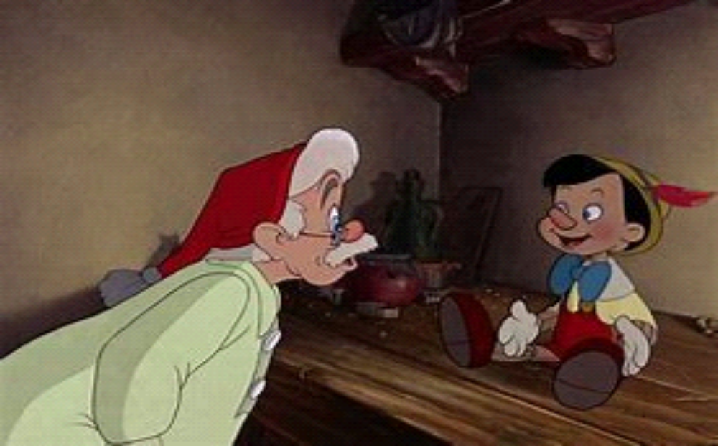
8. What is the name of the man who created Pinocchio?

Slide 10
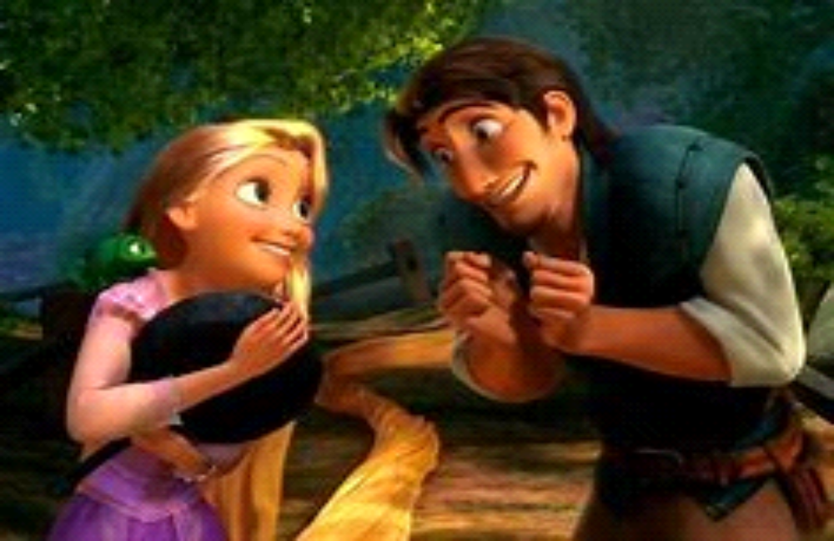
9. What is Flynn Rider's real name in Tangled?

Slide 11
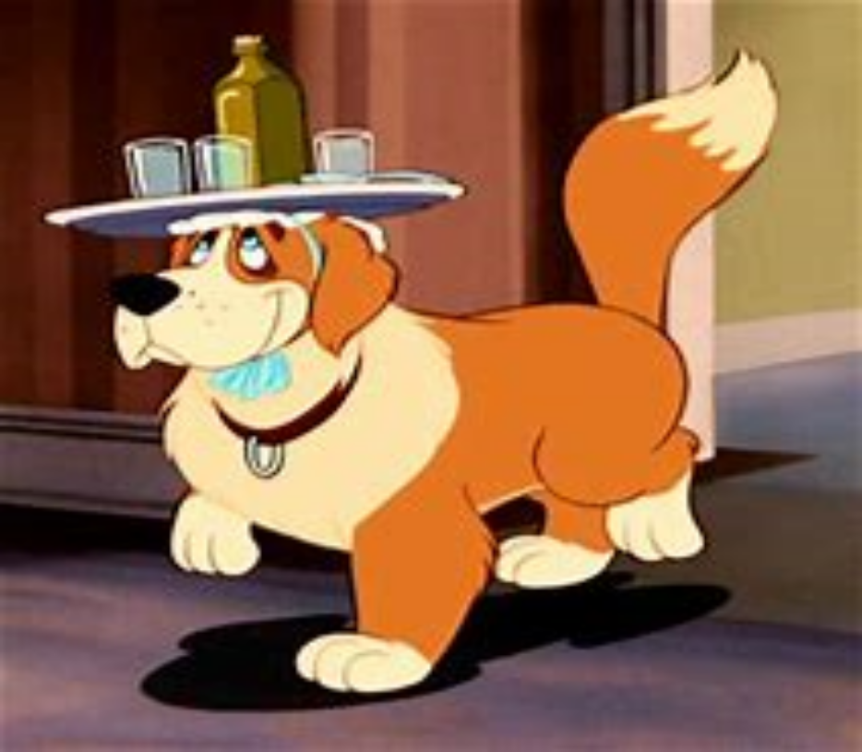
10. What is the name of the Darling's dog in Peter Pan?

Slide 12
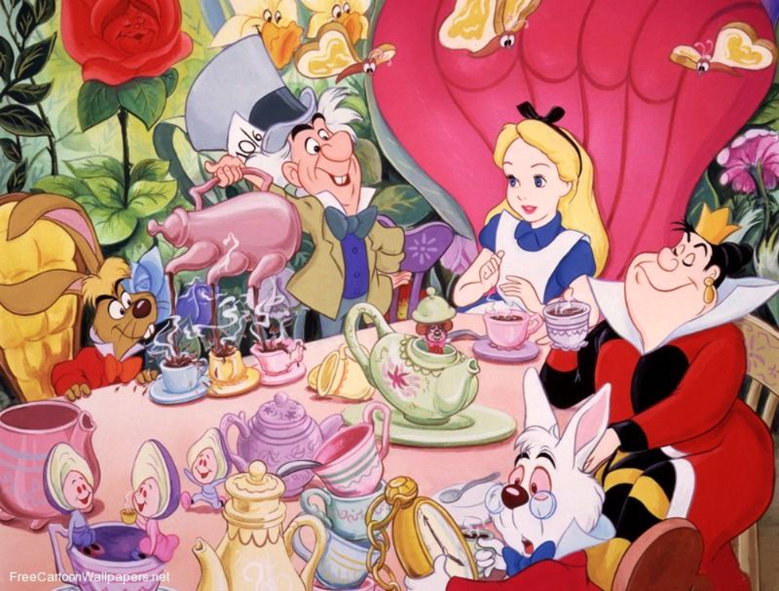
11. In Alice in Wonderland what is the Mad Hatter celebrating at a tea party with the March Hare and Doormouse?

Slide 13
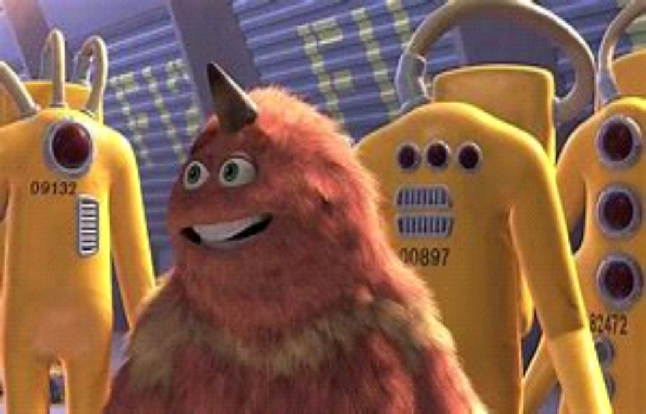
12. In Monsters Inc what item of clothing is stuck to one of the scarer's backs when they return from a door, triggering a code '23-19'?

Slide 14
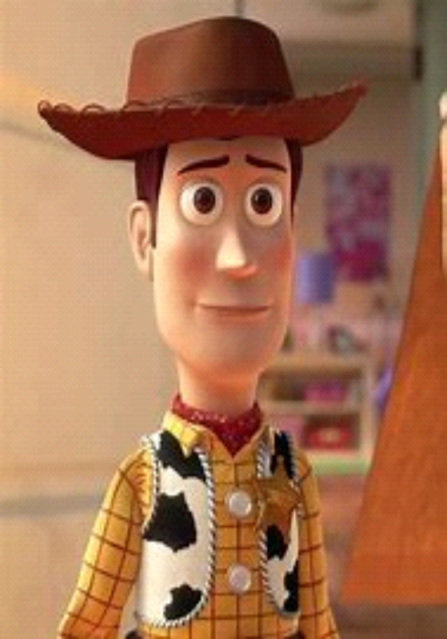
13. What does Woody have written on the bottom of his Cowboy Boots in Toy Story?

Slide 15
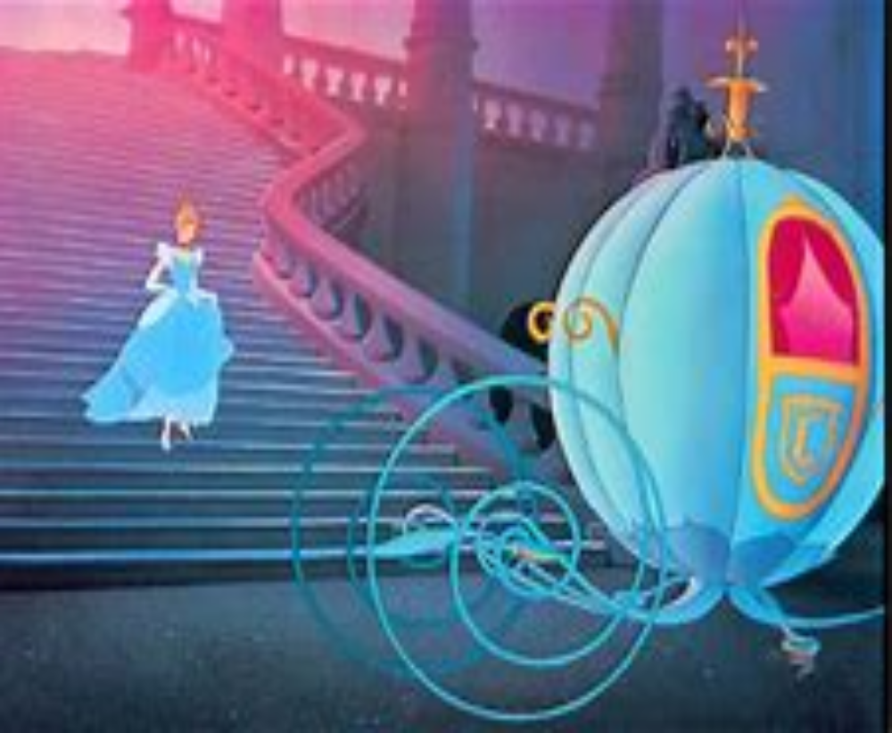
14. What does Cinderella lose at midnight?

Slide 16
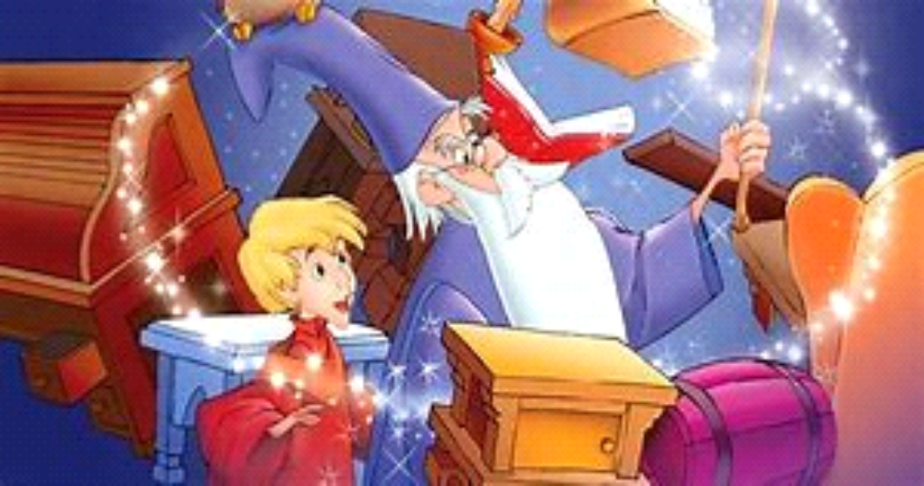
15. What is the name of the Wizard in Sword in the Stone?

Slide 17
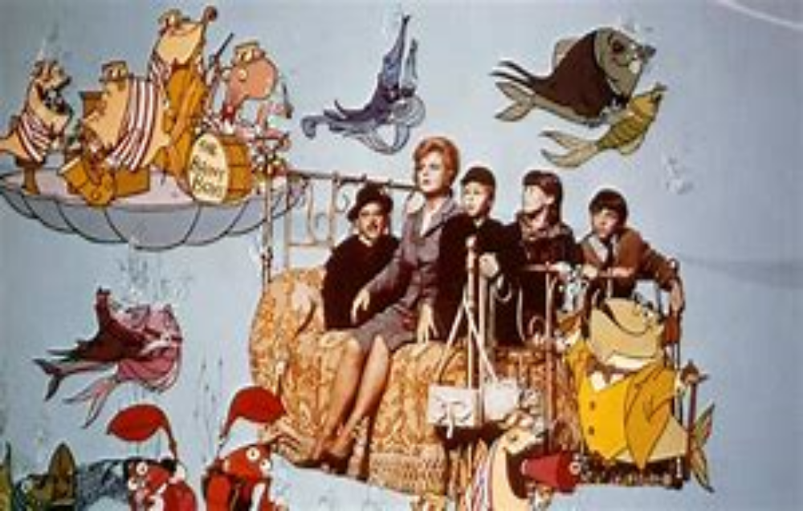
16. What Island does the Bed take them to in Bebknobs and Broomsticks?

Slide 18
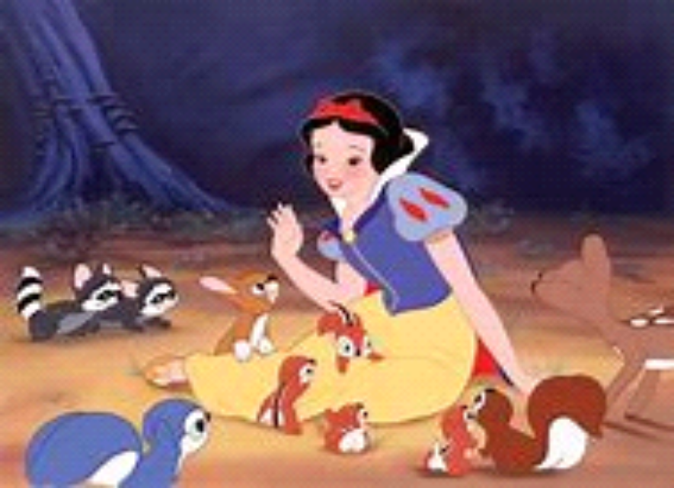
17. What makes Snow White fall into a deep sleep when she eats it?

Slide 19
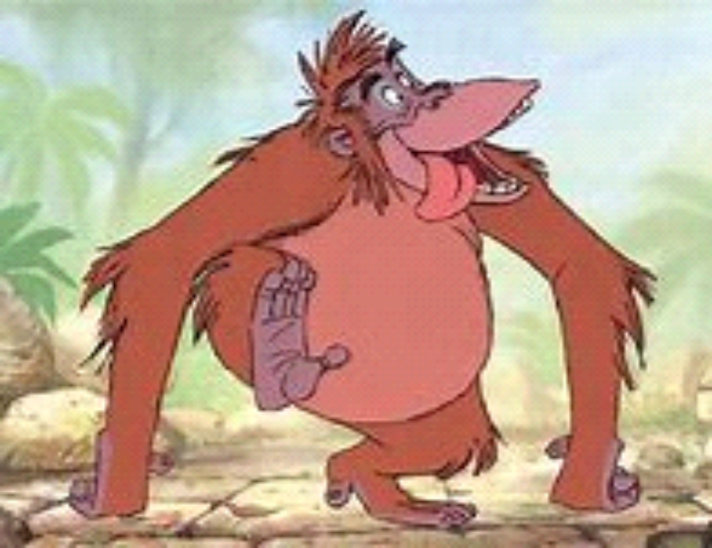
18. What is the name of the Monkey King in the Jungle Book?

Slide 20
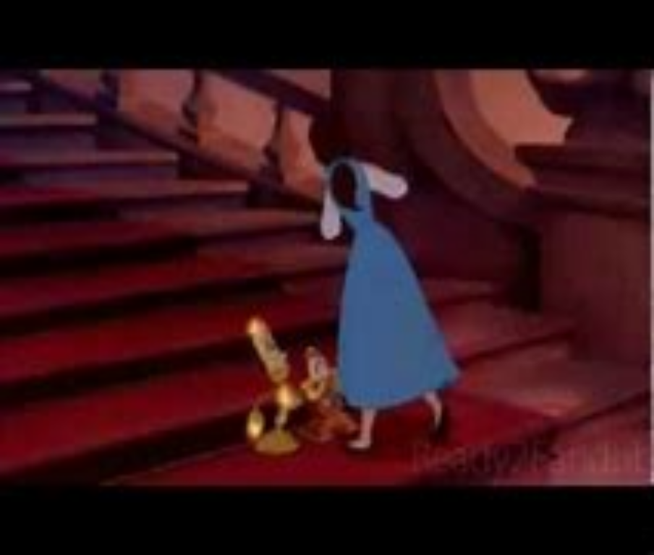
19. In Beauty and the Beast, where must Belle not go in the Beasts castle?

Slide 21
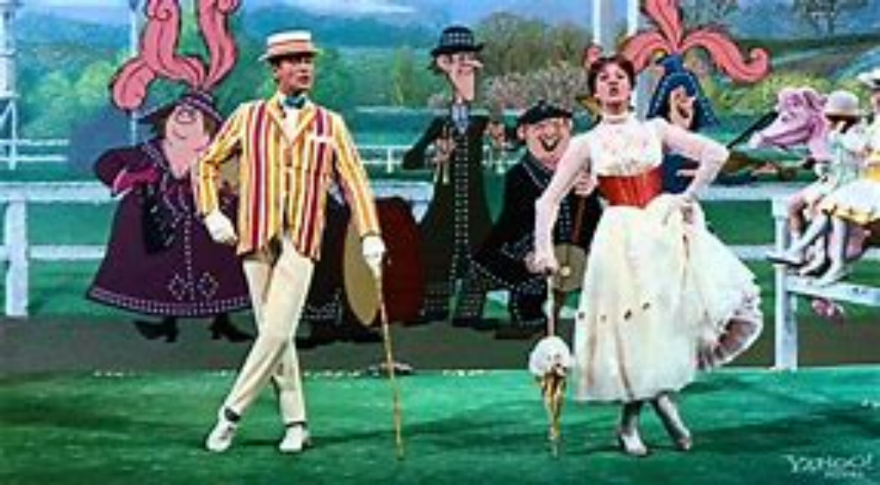
20. What does Mary Poppins ride when she jumps through the chalk painting?

Slide 22
1. What is the name of Elsa and Anna's Kingdom in Frozen?
The answer: Arundel

Slide 23
2. What is the address of the Dentist office in which Nemo is kept in Finding Nemo?
The answer: 42 Wallaby Way, Sydney

Slide 24
3. What is the name of the Prince that Ariel falls in love with in The Little Mermaid?
The answer: Prince Eric

Slide 25
4. In Wreck It Ralph, what is the name of the 'good guy' in Ralph's game?
The answer: Fix it Felix Junior

Slide 26
5. In The Aristocats what is the name of the streetcat who befriends Duchess and her kittens?
The answer: Thomas O'Malley

Slide 27
6. In the original 1994 version of The Lion King, which characters distract the hyenas with a Hawaiian luau?
The answer: Timon and Pumba

Slide 28
7. Where is Lilo & Stitch set?
Hawaii
The answer: Hawaii

Slide 29
8. What is the name of the man who created Pinocchio?
The answer: Giupeto

Slide 30
9. What is Flynn Rider's real name in Tangled?
The answer: Eugene Fitzherbert

Slide 31
10. What is the name of the Darling's dog in Peter Pan?
The answer: Nana

Slide 32
11. In Alice in Wonderland what is the Mad Hatter celebrating at a tea party with the March Hare and Doormouse?
The answer: Unbirthday

Slide 33
12. In Monsters Inc what item of clothing is stuck to one of the scarer's backs when they return from a door, triggering a code '23-19'?
The answer: Sock

Slide 34
13. What does Woody have written on the bottom of his Cowboy Boots in Toy Story?
The answer: Andy

Slide 35
14. What does Cinderella lose at midnight?
The answer: Glass Slipper

Slide 36
15. What is the name of the Wizard in Sword in the Stone?
The answer: Merlin

Slide 37
16. What Island does the Bed take them to in Bebknobs and Broomsticks?
The answer: Isle of Naboombu

Slide 38
17. What makes Snow White fall into a deep sleep when she eats it?
The answer: Poisoned Apple

Slide 39
18. What is the name of the Monkey King in the Jungle Book?
The answer: King Louis

Slide 40
19. In Beauty and the Beast, where must Belle not go in the Beasts castle?
The answer: The West Wing

Slide 41
20. What does Mary Poppins ride when she jumps through the chalk painting?
The answer: Carousel Horse

Slide 42
